Slide 1

Scheduling problem
Johnson algorithm implementation

Slide 2
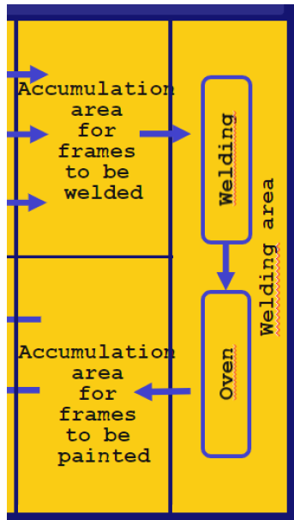
Overview
In the accumulation area we have different batches of tubes waiting to enter in the welding machine first and then in the oven
Every tube has different welding times and different oven times
The objective is to minimize the total time spent processing tubes by finding an optimal schedule

Slide 3
MS-SQL Server
The first thing we need to do is to setup our MS-SQL Server database
We declare 2 tables to save data:
cutted_tubes: id, processing_time_on_welding, processing_time_on_oven,batch_id
job_assignments: tube_id, machine_id, batch_id, start_time, end_time
Outputs from the program will be saved on these tables

Slide 4
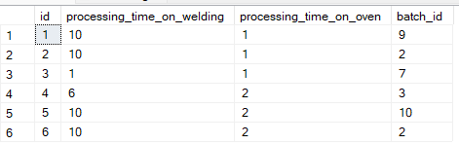
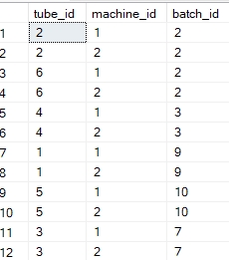
EXAMPLE
We generate batches of tubes randomly with different processing times.
We apply the johnson algorithm and we save in the table job_assignments
cutted_tubes
job_assignments

Slide 5
Johnson algorithm implementation
It minimizes the flow time through the 2 machines:
K = 1; l=n
Unscheduled jobs = {J1, …, Jn}
Find the min between ai and bi
If the min is ai we put the corresponding job Ji in position k of the scheduling jobs, we delete Ji from unscheduled jobs, k = k+1, go to 6)
If the min is bi we put Ji in position I of scheduled jobs, I = I -1, go to 6)
If the list of unscheduled jobs is not empty go to 3); else the list of scheduled jobs is optimal

Slide 6
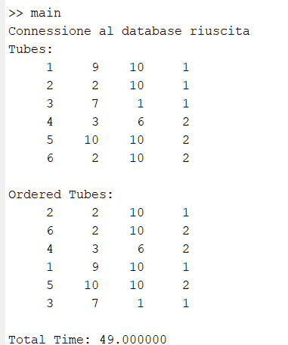
Example (2)
This is the output of the program in the command line:
First matrix: generated tubes with different welding and oven times
Second matrix: ordered tubes matrix
Total time to finish all the jobs

Slide 7
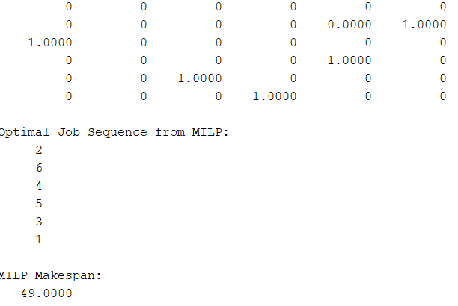
Mathematical problem approach
We try to solve the scheduling problem with a mathematical problem formulation approach with different optimization variables and constraints (see code)
X binary optimization variable => matrix n x n
X(i,j) = 1 if job in position i precedes job in position j
X(i,j) = 0 else
This variable is used to get the optimal schedule
The column with all elements = 0 is the first job in the optimal schedule

Slide 8
Different instances
Tubes are generated randomly everytime we execute the project
Tables from the sql server are cleared before we save the new generated tubes in them
The total makespan is always different with different jobs

Slide 9
usage

